Slide 1
Ansible
Venkat Gurumoorthi

Slide 2
Agenda
Introduction to Ansible
Setting up an Ansible working environment

Slide 3
Introduction
Configuration Management
Infrastructure as a code
Provisioning
Deployment
Orchestration
Monitoring and Alerting
Logging

Slide 4
Ansible
Prerequisites to learn Ansible
Features of Ansible
Ansible architecture
How Ansible works?
Installing Ansible

Slide 5
Prerequisites to learn Ansible
Connect to a remote machine using SSH
Interacting with the command line shell
Installing packages
Use the sudo command
Check and set file permissions
Start and stop services
Set environment variables
Write scripts, if you are going to write your own modules

Slide 6
Features of Ansible
Easy to read syntax
Agentless
Push based
Built in modules
Idempotence
Template

Slide 7
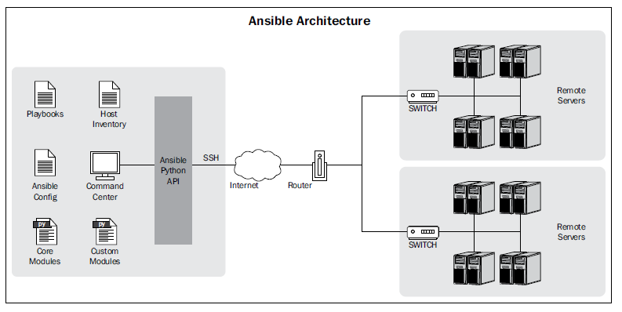
Ansible architecture

Slide 8
Ansible architecture
Ansible configuration file
Host inventory file
Remote machines
Playbooks
Built-in modules
Custom modules

Slide 9
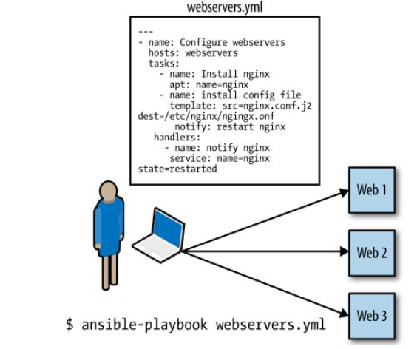
How Ansible works

Slide 10
Installing Ansible
Directly from source
Installing via a package manager

Slide 11
Setting up the environment
Log into AWS console after creating user accounts
Create 4 EC2 instances
Generate private security file to log into the hosts
Assigning Elastic IP addresses

Slide 12
Configuring Ansible
Using environment variables
Using ansible.cfg
Hostfile
Library
Forks
Sudo_user
Remote_port
Host_key_checking
Timeout
Log_path

Slide 13
Configuration Management
Working with Playbooks
The anatomy of a playbook
Hosts
Remote_user
Tasks

Slide 14
Variables
Variables names
Valid and invalid names
Variables in an included task file
Variables in a playbook
Variables in a global file
Facts as variables
Command line variables
Variables in an inventory file

Slide 15
Working with inventory file
The basic inventory file
Groups in an inventory file
Groups of groups
Regular expression with an inventory file
External variables
Host variables
Group variables
Variable files
Overriding configuration parameters with an inventory file

Slide 16
Working with modules
Command module
File module
The source control module

Slide 17
Command module
Command module
Raw module
Script module
Shell module

Slide 18
File module & The source control module
File module
Debugging in ansible
Template module
Copy module

